Slide 1
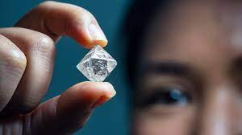

Prediction How is Diamond Priced Based on its Attributes
Project Proposal
Amal Nassier Almuteb

Slide 2
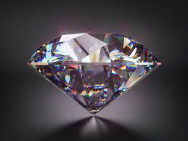

Introduction
Diamonds have become important indispensable resources for humans. Its versatility makes it a highly valued element in our society. Hence, people are willing to pay a lot of money for objects created using diamonds.
Due to the combination of different features for determining its worth, a diamond's price could range from a couple hundred dollars to millions of dollars.

Slide 3
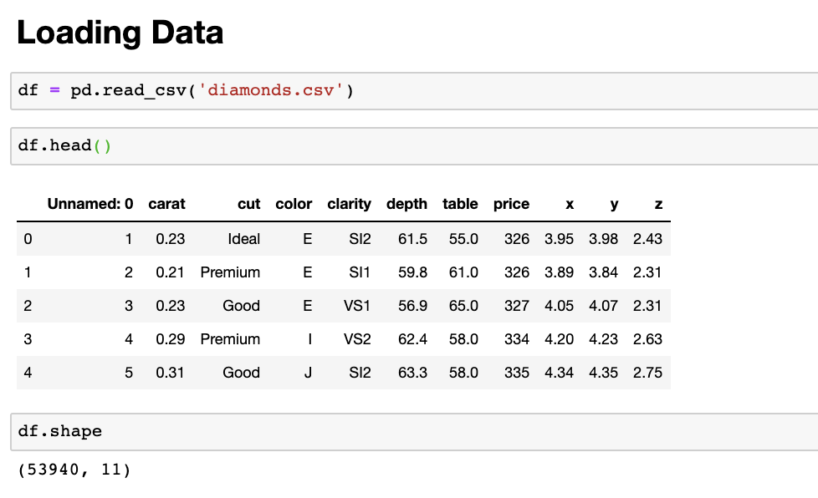
Dataset Description
54000 rows
10 variables
Diamonds dataset hosted on Kaggle.
and contains
Content
Price is in US dollars
Carat weight of the diamond
Cut quality of the cut (Fair, Good, Very Good, Premium, Ideal)
Color diamond color, from J (worst) to D (best)
Clarity a measurement of how clear the diamond is
x length in mm
y width in mm
z depth in mm
depth: The height of a diamond
table: The width of the diamond’s table expressed as a percentage of its average diameter

Slide 4
Project Target and Some potential problem that can be discussed in the dataset
Fully understand how the pricing system of diamonds worked.
Visualization the important qualities of a diamond.
Created a predictive model to predict the prices of diamonds.

Slide 5
Algorithm
01
02
03
04
Make the linear regression model based on the following steps:
05
Import Required Packages
Load the dataset
Perform the exploratory data analysis (EDA)
Create a linear regression model
Train the model
to fit the data
Make predictions using the trained model

Slide 6
Tools
Pandas:
Numpy:
Matplotlib:
Seaborn:
a library offers data structures and operations for manipulating numerical tables and time series.
a library used for working with arrays. It also has functions for working in domain of linear algebra, fourier transform, and matrices.
a plotting library for the Python programming language and its numerical mathematics extension NumPy.
a data visualization library built on top of matplotlib and closely integrated with pandas data structures in Python.

